Slide 1
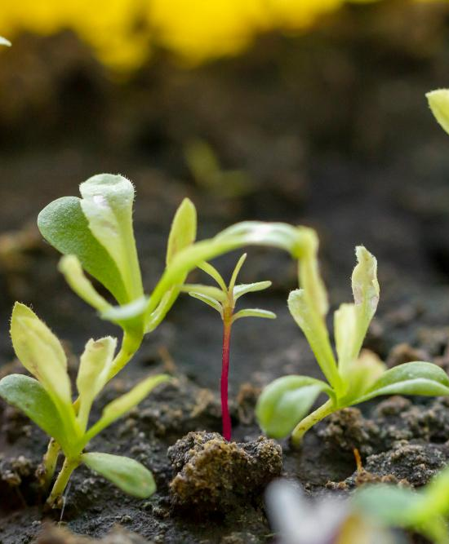
Intelligent Irrigation: Optimizing Water Use with Sensors and Machine Learning.
Under the Guidance of Dr. Vivek Sharma

Slide 2
Team Members
Avinash Kumar Gautam
Aryan Sandeep Patil
Atulya Juyal
23BCE10901
23BCE10971
23BCE10984
Shoyuj Sharma
23BCE10955

Slide 3
Content
• Project title, guide & team members
• Introduction
• Existing work with limitations
• Proposed work and methodology
• Novelty of the project
• Real time usage
• Hardware &amp; software requirements
• Overall system architecture diagram.
• Literature review
• Module description
• Module work flow explanation.
• Implementation and coding.
• Demo video.
• Snap shot of your project.
• Testing.
• Result and Discussion. (Input and output)
• Conclusion.

Slide 4
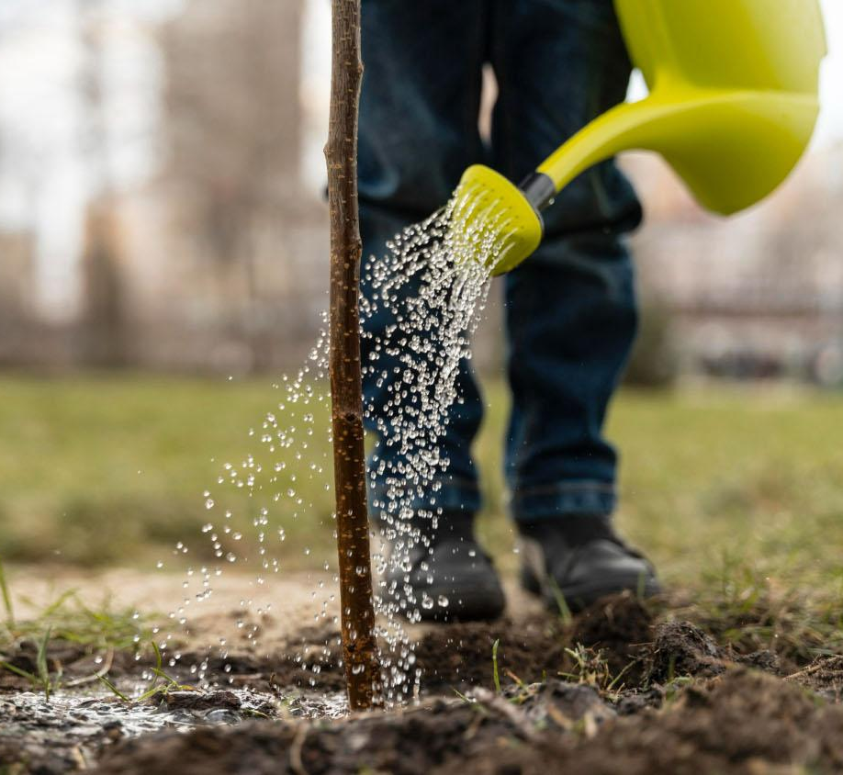
Introduction
As water scarcity becomes an increasingly pressing global issue, the agriculture industry is seeking innovative ways to optimize irrigation and reduce water waste. This presentation will explore how the integration of sensor technology and machine learning algorithms can transform traditional irrigation practices, leading to improved crop yields, reduced environmental impact, and more sustainable water management.

Slide 5
Existing Work with Limitations
Machine Learning in
Agriculture:
Traditional Irrigation Systems:
Sensor-Based Irrigation:
3
1
2
KNN algorithms to analyze patterns in soil data and predict irrigation needs.
Manual systems based on farmer experience.
Inefficient water use due to over-irrigation or under-irrigation.
Limited integration of environmental data (e.g., weather, soil condition).
Systems using soil moisture and temperature sensors to monitor crop conditions.
Example: Arduino and IoT-based soil moisture detectors.

Slide 6
Limitations of current system
Limited Data Integration:
Many systems focus only on soil moisture, ignoring factors like temperature, humidity, or crop type.
Lack of real-time climate data integration can lead to suboptimal decisions.
Cost Constraints:
Advanced sensor networks and IoT setups can be expensive, making them inaccessible for small-scale or low-income farmers.
Energy Dependence:
Many systems rely on continuous power supply or high-capacity batteries, which can be impractical in rural areas with unreliable electricity.
Algorithmic Limitations:
Basic machine learning models like KNN are effective for small datasets but can struggle with scalability and complex patterns.
Lack of real-time model retraining may reduce accuracy over time as conditions change.
Hardware Vulnerability:
Sensors may degrade over time due to environmental exposure (e.g., moisture, heat, or pests).
Maintenance and calibration require technical expertise.
Lack of Customization:
Current systems may not account for regional variations in soil type, crop requirements, and water availability.
Connectivity Challenges:
Dependence on internet or cellular networks limits usability in remote areas.

Slide 7
Proposed Work and Methodology.
The aim of the project is to design an intelligent irrigation system that prevents water logging in crops and ensures optimal water usage by:
Developing a Machine Learning-Based System:
Using the K-Nearest Neighbors (KNN) algorithm to predict irrigation requirements based on soil and environmental data.
Integrating Real-Time Sensors:
Deploying sensors to collect real-time data on:
Soil Moisture: Determines if water is required.
Temperature: Helps assess evaporation rates.
Humidity: humidity trends.
Triggering Smart Irrigation:
Automatically starting and stopping irrigation based on model outputs to prevent over-watering or water logging.
Optimizing Water Use:
Ensuring water is delivered only when needed, reducing waste and improving crop health.

Slide 8
Methodology
Step 1: Data Collection
Use sensors to gather the following data from the field:
Soil moisture level (in %)
Air temperature (in °C)
humidity.(g/m^3)
Collect historical data from meteorological databases for training the model
Step 2: Data Preprocessing
Cleaning: Handle missing or inconsistent data (e.g., sensor errors).
Normalization: Standardize data to ensure fair comparison between features like temperature and soil moisture.
Feature Engineering: Select and combine relevant features (e.g., combining soil moisture and rainfall predictions to refine irrigation timing).

Slide 9
Methodology
Step 4: System Design
Hardware Setup:
Sensors: Install soil moisture sensors and temperature probes in the field.
Communication Module: Use IoT devices (e.g., Raspberry Pi or Arduino) to send sensor data to the cloud or local server.
Actuators: Use motorized valves or pumps to control water flow.
Step 3: Algorithm Development
KNN Algorithm:
Train the model using labelled datasets where irrigation needs (yes/no) are known.
Input Features:
Soil Moisture
Temperature
Humidity Condition
Output:
Irrigation Decision (Water or No Water).
Software Development:
Create a script that:
Collects data from sensors.
Sends it to the machine learning model for processing.
Executes irrigation commands when necessary.

Slide 10
Methodology
Step 5: Testing and Validation
Conduct field trials to validate the model’s performance:
Test on crops prone to waterlogging.
Measure water usage and crop growth over a defined period.
Compare system output with manual irrigation to evaluate efficiency and accuracy.
Step 6: Scalability and Optimization
Explore additional algorithms for better accuracy or scalability.
Optimize the system for:
Energy efficiency (e.g., use solar panels).
Low-cost implementation for small farmers.

Slide 11
Flowchart of the Methodology
You can include a flowchart to visualize the process:
Sensors → Collect real-time data
Preprocessing → Normalize and clean data
KNN Model → Predict irrigation needs
Irrigation System → Trigger water pumps
Feedback → Monitor soil condition post-irrigation

Slide 12
Novelty of the Project.
1. Integration of Real-Time Data with Machine Learning
Unlike traditional irrigation systems that rely on fixed schedules or manual control, your project uses real-time data from soil moisture sensors, temperature sensors, and climate predictions to make intelligent decisions.
By employing the K-Nearest Neighbors (KNN) algorithm, the system learns from historical and real-time data to improve irrigation predictions.
3. Affordable and Scalable Solution
The use of low-cost sensors and the KNN algorithm (a computationally efficient model) makes your solution affordable for small and large-scale farmers.
The scalability of the system allows it to be deployed across various types of farms, irrespective of size or location.
4. Potential for Future Enhancements
The system is designed to be modular, allowing future integration of more advanced machine learning models, such as neural networks, for better prediction accuracy.
Additional features, like mobile app integration for remote monitoring and control, make it highly adaptable and user-friendly.
1. Integration of Real-Time Data with Machine Learning
Unlike traditional irrigation systems that rely on fixed schedules or manual control, your project uses real-time data from soil moisture sensors, temperature sensors, and climate predictions to make intelligent decisions.
By employing the K-Nearest Neighbors (KNN) algorithm, the system learns from historical and real-time data to improve irrigation predictions.

Slide 13
Real Time Usage:-
01
02
03
Water Conservation
Dynamic Decision Making
Prevention of Water lodging
The system collects real-time data from soil moisture sensors, temperature sensors, and Air Humidity.
Based on this data, the machine learning model (KNN) decides whether irrigation is required or not.
The system continuously monitors soil moisture levels and ensures irrigation stops before excess water accumulates, protecting crops from water damage.
Real-time analysis ensures water is supplied only when necessary, reducing waste and improving sustainability.

Slide 14
Real Time Usage:-
04
05
06
Improved crop health and yield
Remote monitoring and automation
Scalability of Diverse Crops
With precise and timely irrigation, crops receive optimal water, improving growth, yield, and resistance to diseases caused by overwatering.
The system can be connected to a mobile app or dashboard, allowing farmers to monitor and control irrigation in real-time from anywhere.
The real-time nature makes it adaptable to different types of crops and soil conditions, enhancing its utility across various agricultural setups.

Slide 15
Hardware Requirements:
1.IOT Sensors:
Soil Moisture Sensor(FDR ,TDR sensor): To measure the moisture level in the soil.
Temperature Sensor (e.g., DHT11/DHT22): To record temperature and humidity.
Humidity Sensor : To gather climate-related data.
2. Arduino Uno/Nano or Raspberry Pi for data collection and system control.
3. Water Pump and Valves:
For irrigation system activation and control.
4. A battery or solar-powered system for reliable and sustainable energy.
5. SD card module for storing historical data locally.
6. Jumper wires, breadboards, resistors, and other connectors for circuit setup.

Slide 16
Software Requirements:
1. Programming Tools:
Arduino IDE: To program the Arduino board.
Python: For processing data, implementing the KNN algorithm, and visualization.
2. Machine Learning Libraries:
scikit-learn: For implementing the KNN algorithm.
NumPy and Pandas: For data processing and analysis.
Matplotlib for graphs .
3. Database Services:
CSV files: To store and manage sensor data.
4. Web Development :
. HTML, CSS and JavaScript For creating a web interface.
5. Data Visualization Tools :
Matplotlib : For creating graphs and insights.

Slide 17
Flow Diagram: -
Data Collection
Data Processing
KNN Decision Making
Irrigation Activation
Monitoring and Feedback

Slide 18
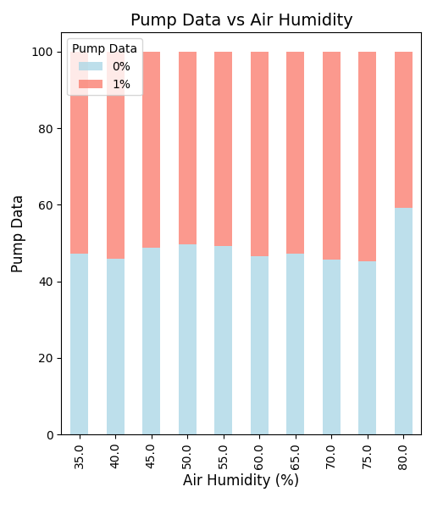
Performance Graphs.

Slide 19
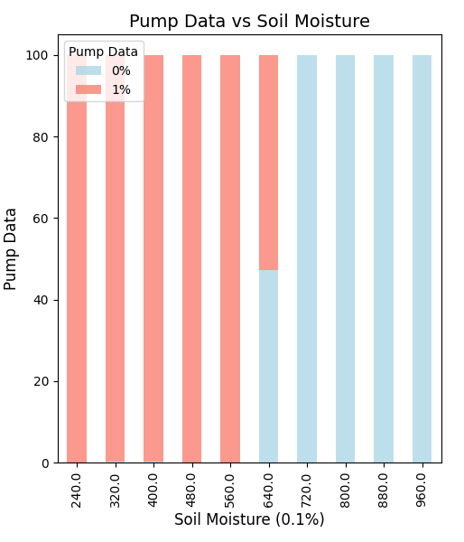
Performance Graphs.

Slide 20
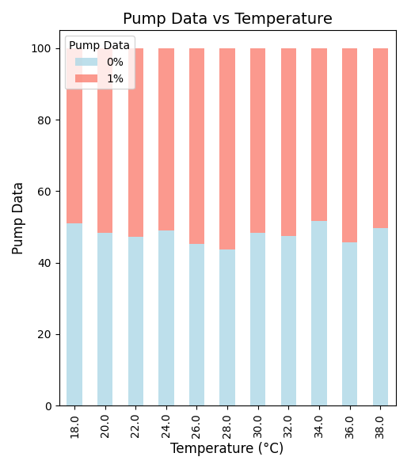
Performance Graphs.

Slide 21
Literature Review
1. Traditional Irrigation Systems
Traditional methods, like flood irrigation or manual watering, are still widely used but are inefficient and lead to significant water wastage.
Research highlights that these systems often cause issues like overwatering or under-irrigation, affecting crop yields negatively.
Limitation:
These methods lack precision and adaptability to dynamic environmental conditions.
2. IoT-Based Irrigation Systems
IoT-based solutions integrate sensors, cloud platforms, and mobile applications for remote monitoring and control.
Research by [Author Name, Year] demonstrated the use of IoT for precision agriculture, resulting in 20% better water utilization.
Limitation:
High setup costs and reliance on stable internet connectivity limit adoption in rural areas.
3. Machine Learning in Irrigation
Machine learning (ML) models are being used to predict irrigation needs based on sensor data.
A study by [Author Name, Year] used the Support Vector Machine (SVM) algorithm to classify irrigation requirements, achieving 85% accuracy.
Limitation:
Most ML models require significant computational power, which can make real-time processing challenging for small-scale farmers.

Slide 22
Literature Review
4. Focus on Waterlogging Prevention
Research addressing waterlogging issues is limited. A few studies emphasize the use of threshold-based systems, but they often fail to adapt dynamically to real-time conditions.
Limitation:
Static thresholds are insufficient to handle variability in soil and environmental conditions.
Research Gap
The existing literature demonstrates the potential of automated and intelligent irrigation systems but highlights gaps:
Limited focus on real-time waterlogging prevention.
High costs and complexity of current ML-based systems hinder scalability for small-scale farmers.
Insufficient integration of sensor feedback loops for continuous irrigation adjustment.

Slide 23
Module Description and Work Flow.
Data Processing Module
Machine Learning Decision Module
Data Acquisition Module
Purpose: To preprocess and clean the sensor data
Input: Raw sensor data.
Process:
normalization, and handling of missing data.
Preparing data for the machine learning algorithm.
Output: Processed data ready for analysis.
Purpose: To predict irrigation needs using the KNN algorithm.
Input: Processed sensor data (soil moisture, temperature, and Humidity).
Process:
KNN model evaluates the data against pre-trained patterns.
Determines whether irrigation is required.
Output: Decision (e.g., "Start Irrigation" or "No Irrigation Needed").
Purpose: To collect real-time environmental and soil data.
Input: Sensor readings (e.g., soil moisture, temperature, and Humidity data).
Process:
Sensors gather data and send it to the microcontroller
Output: Raw data for processing

Slide 24
Module Description and Work Flow.
User Interface Module
Actuation Module
Purpose: To provide a platform for users to monitor and control the system remotely.
Input: User commands (e.g., start/stop irrigation) or system data.
Process:
Display real-time data and graphs.
Allow manual override of the automated system.
Output: Visual insights and remote system control.
Purpose: To execute the irrigation process based on the decision.
Input: Decision from the ML module.
Process:
If irrigation is required, the relay module activates the water pump.
Water is delivered to crops through controlled valves.
Output: Controlled irrigation.

Slide 25
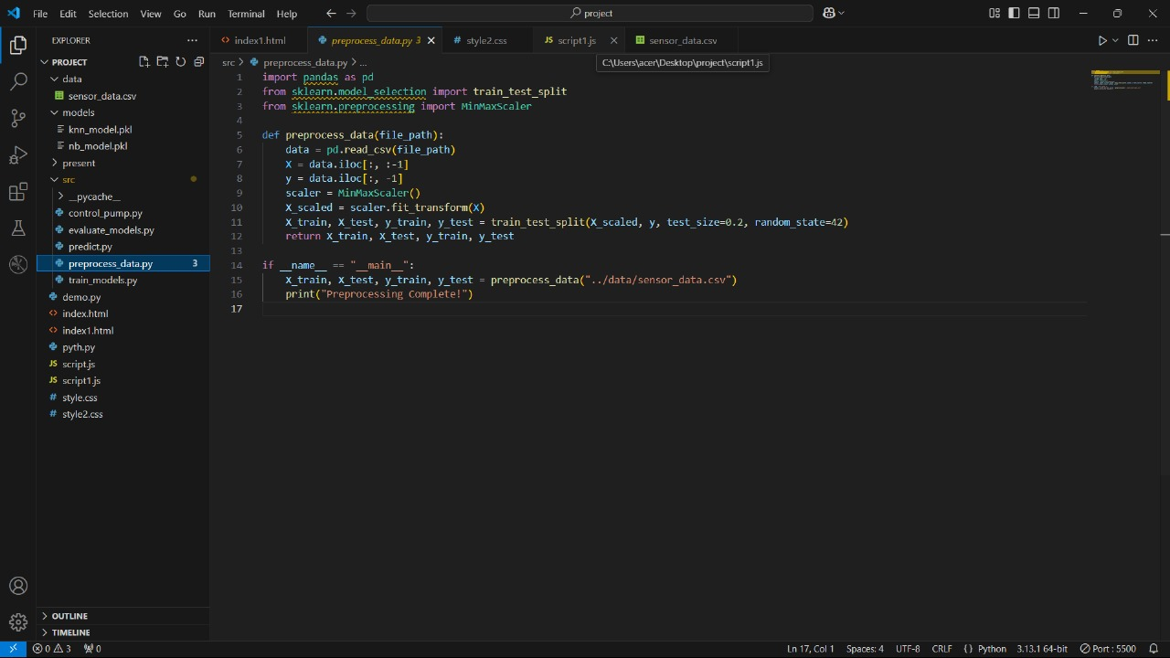
Implementation and Coding

Slide 26


Slide 27
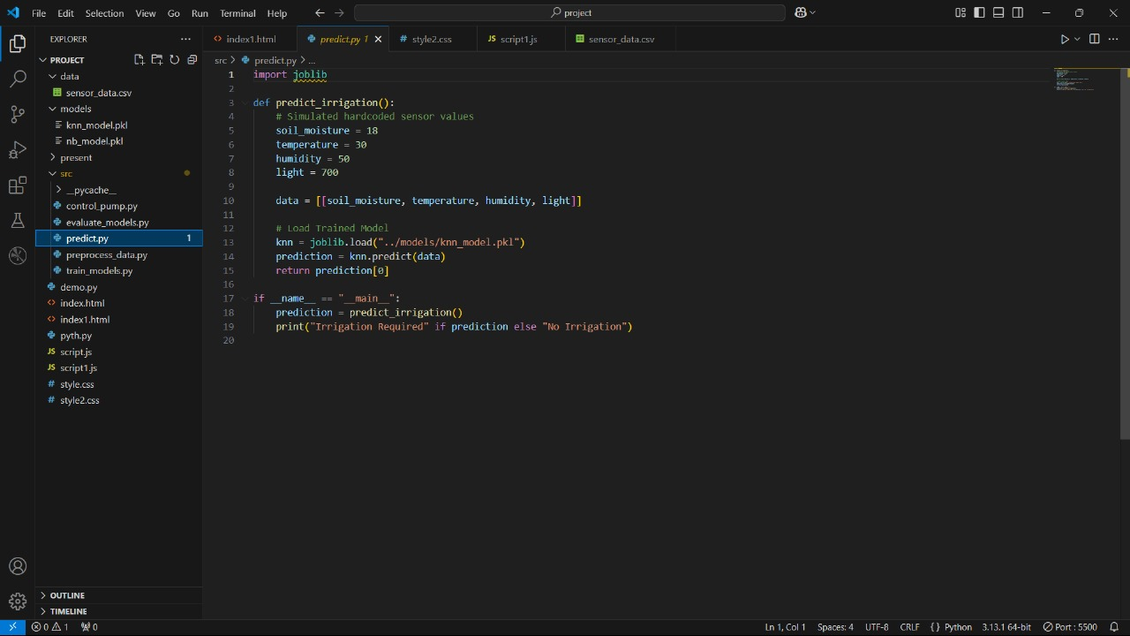

Slide 28
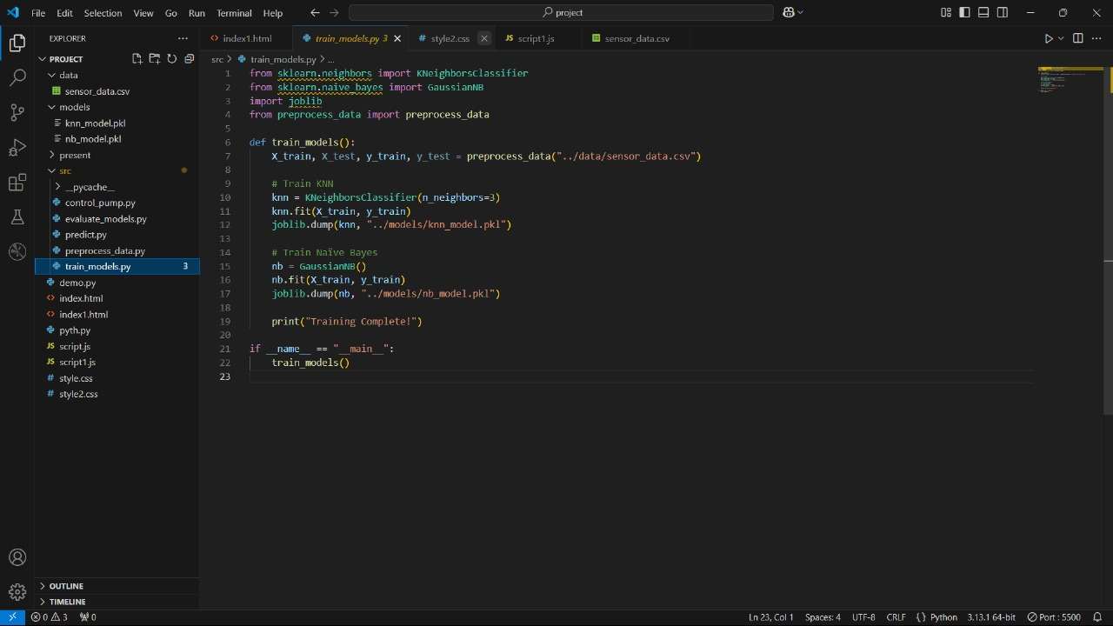

Slide 29
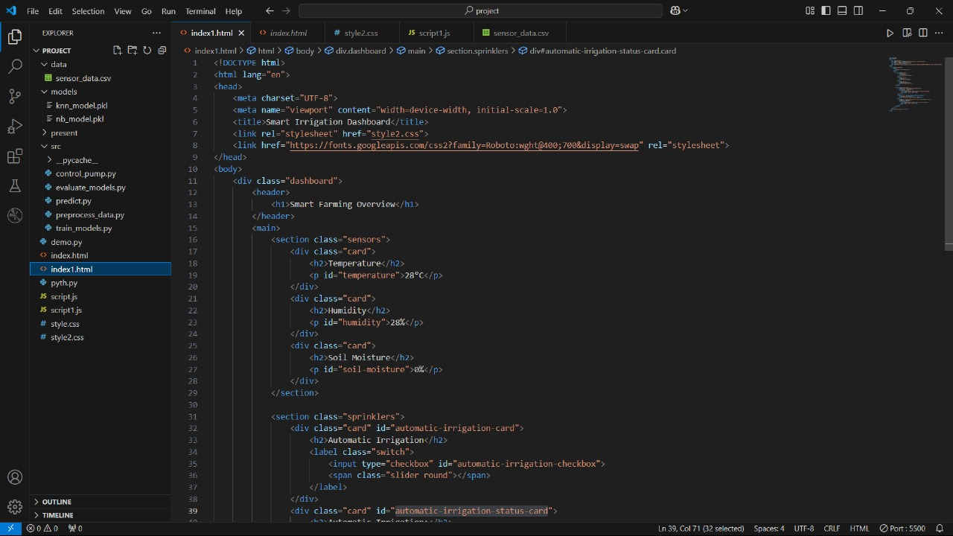

Slide 30
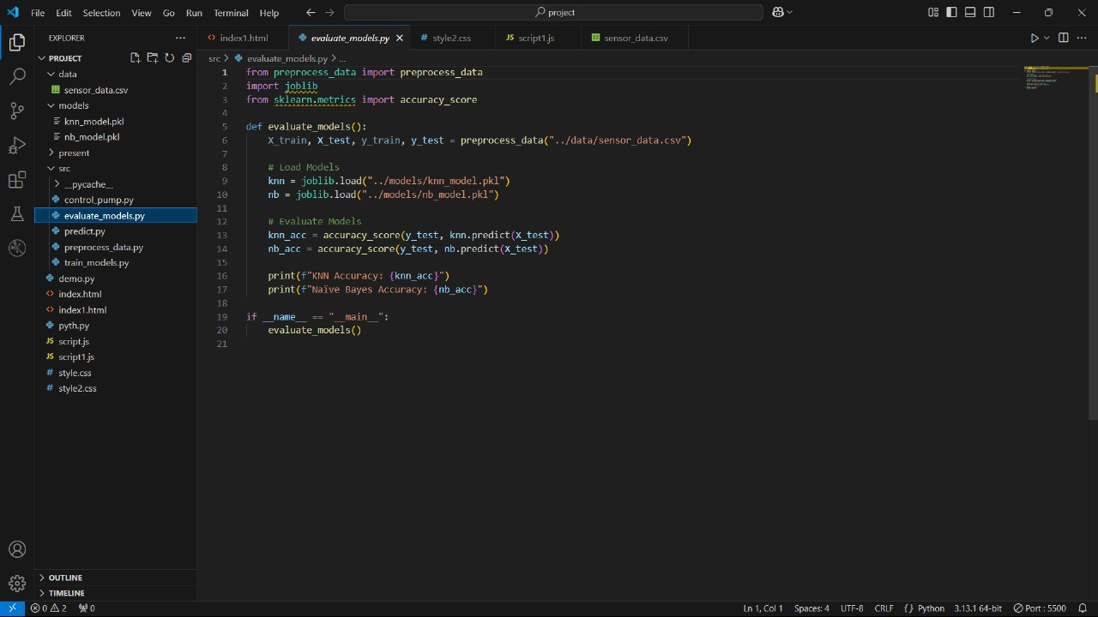

Slide 31
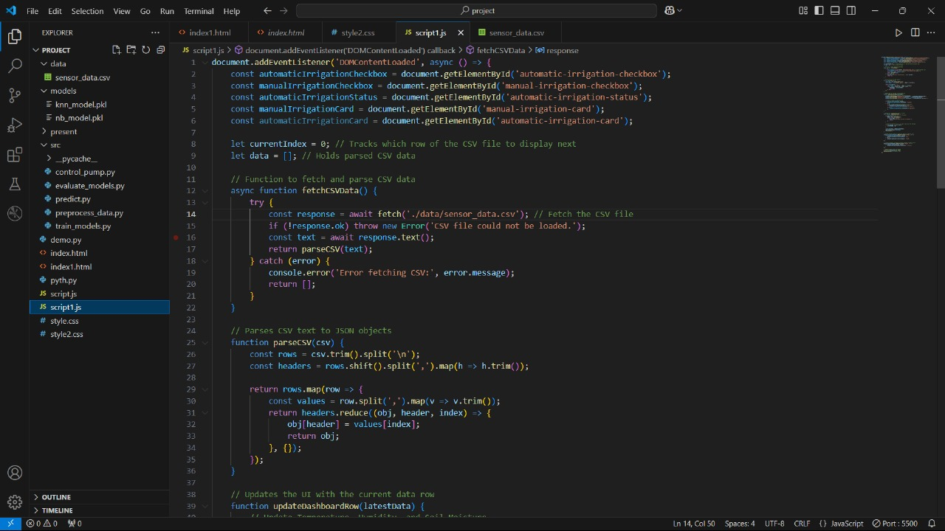

Slide 32
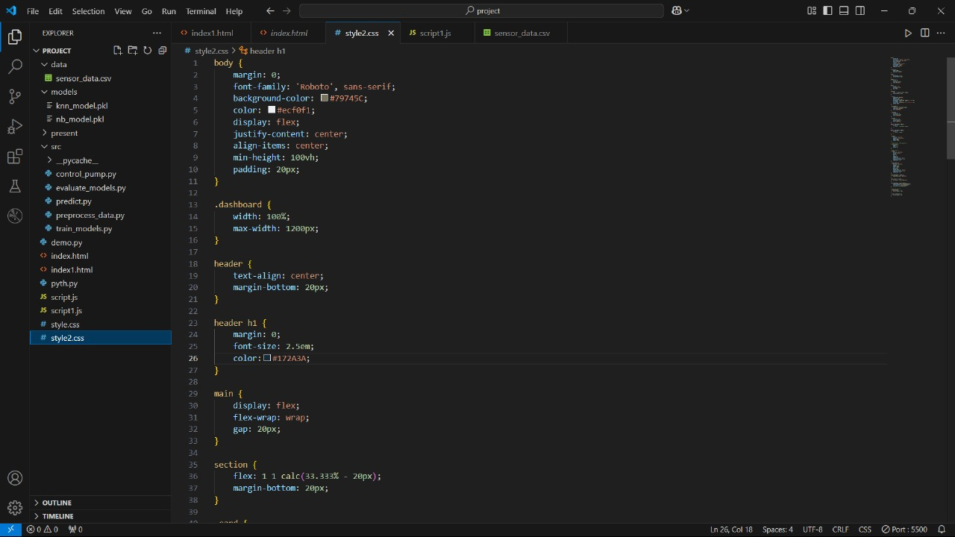

Slide 33
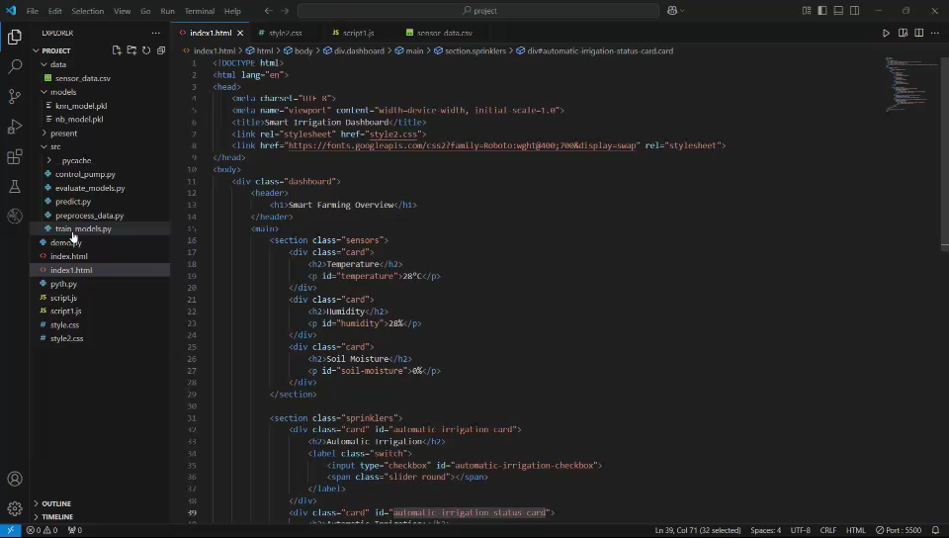
Demo Video

Slide 34
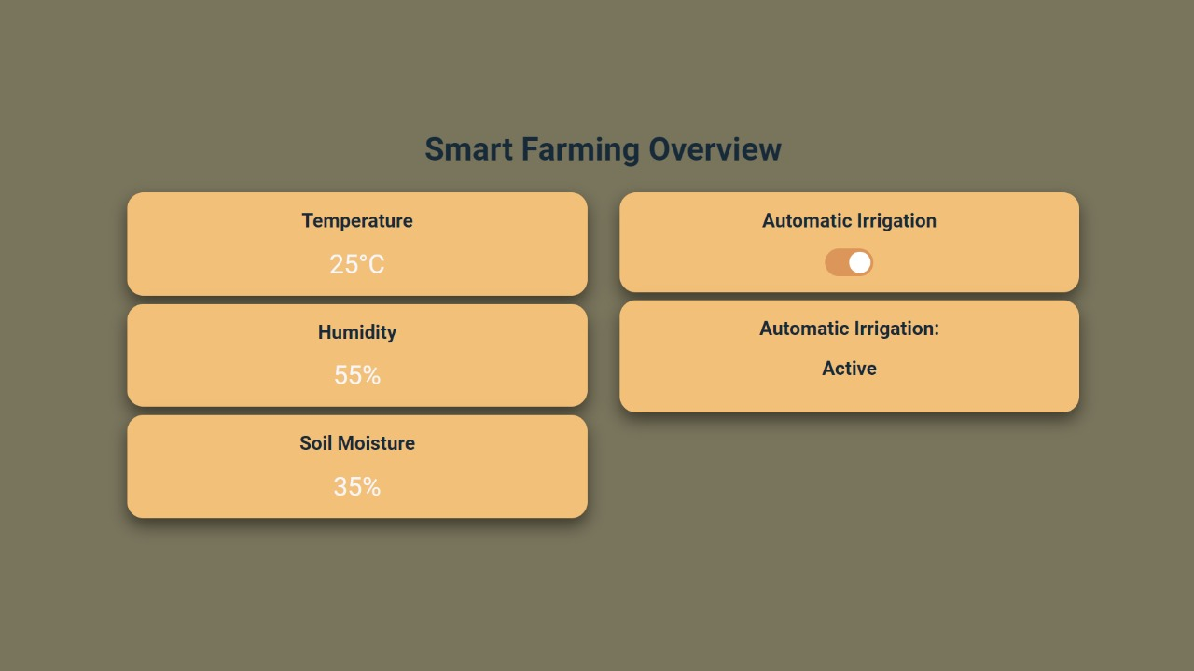
Snapshots of The Project.

Slide 35
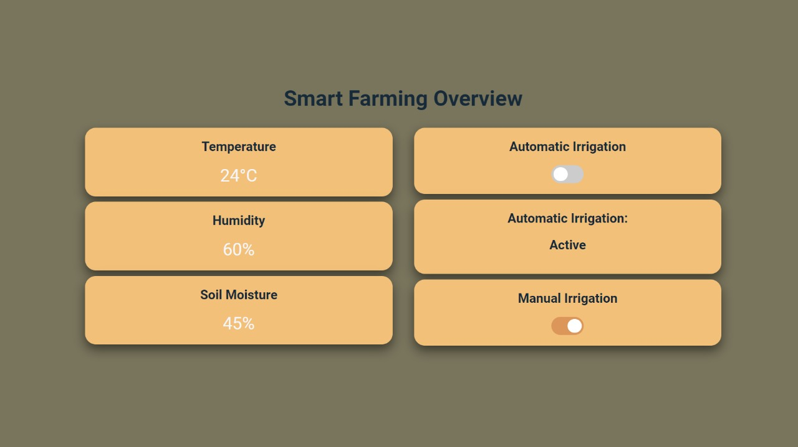
Snapshots of The Project.

Slide 36
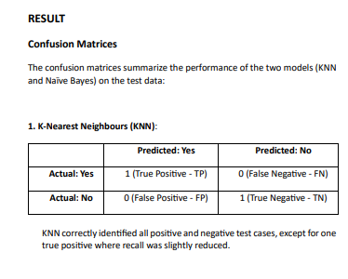
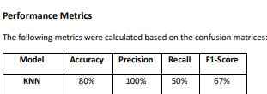
Result and Discussion
KNN Performance:
Accuracy (80%): Indicates that KNN correctly classified 4 out of 5 test cases.
Precision (100%): All predicted positives were correct.
Recall (50%): KNN identified only half of the actual positives.
F1-Score (67%): Balances precision and recall.

Slide 37
Result and Discussion
Discussion.
Key Observations
• Performance of KNN: The KNN model outperformed Naïve Bayes in accuracy (80% vs. 70%) and F1-score (67% vs. 50%). This can be attributed to KNN's ability to model nonlinear decision boundaries effectively. By using a distance-based approach, KNN can handle complex relationships between features such as soil moisture and light intensity, which are critical for irrigation decisions. Despite its simplicity, KNN adapts well to the patterns present in the dataset.
2. Strengths of the Study
• Reproducibility through Simulated Data: The use of a simulated dataset ensures that the study can be replicated by other researchers or practitioners. The dataset provides predefined conditions, allowing for consistent benchmarking of different models without the variability introduced by real-world noise or missing values.
• Lightweight Algorithms for IoT Deployment: Both KNN and Naïve Bayes are computationally lightweight, making them highly suitable for resource-constrained environments like IoT-based smart irrigation systems. The reduced computational overhead ensures these algorithms can run efficiently on microcontrollers or edge devices commonly used in agricultural automation.

Slide 38
Result and Discussion
Discussion.
3. Limitations
• Lack of Real-World Data Variability: The simulated dataset used in this study, while useful for proof of concept, does not fully capture the complexity and variability of real-world agricultural conditions. Factors such as soil type, crop type, and unexpected weather events (e.g., heavy rainfall or sudden drought) are not represented in the data. This limitation could affect the models' performance when deployed in actual field conditions.
• Absence of Hardware Integration: The study did not incorporate hardware components such as sensors, microcontrollers, or irrigation actuators. As a result, the practicality of the models in real-world scenarios remains untested. Factors like sensor noise, hardware failures, or latency in decision execution could significantly influence the system's overall performance.
• Limited Dataset Size: The dataset used for this study was relatively small, with only ten rows of data. While this is sufficient for proof of concept, it limits the generalizability of the results. Larger and more diverse datasets would provide a better understanding of the models’ performance across varying conditions. For example, incorporating data from different seasons .
• Scalability Concerns for KNN: While KNN performed well, it is computationally expensive during prediction, as it calculates distances from all training points for each test case. This limitation may impact scalability, especially in large-scale applications or when deploying the model on devices with constrained computational resources.

Slide 39
Result and Discussion
Discussion.
4. Future Directions
• Use Real-World Datasets:
Collect data from actual agricultural fields, including sensor readings and real irrigation requirements. This would introduce variability and noise, providing a more robust evaluation of the models.
• Hardware Integration: Implement the system with sensors and irrigation controllers to test its real-time performance. For example, soil moisture sensors can provide real-time data, which can be used to validate the system’s decisions.
• Optimize Models: Combine lightweight algorithms with techniques like feature selection or dimensionality reduction to improve performance while maintaining efficiency.
• Expand Dataset Size: Use larger datasets to train and test the models, ensuring they generalize well to diverse conditions.
• Incorporate Advanced Techniques: Explore ensemble methods or hybrid approaches that combine the strengths of KNN and Naïve Bayes to address specific weaknesses.

Slide 40
Conclusion
The paper presents the development of an irrigation prediction system, based on simulated data with a small dataset of ten rows, using machine learning algorithms, K-Nearest Neighbours (KNN) and Naïve Bayes (NB), and assesses whether irrigation is necessary with environmental factors such as moisture in the soil, temperature, humidity, and light intensity. The results showed that KNN outperformed Naïve Bayes in terms of accuracy, precision, and F1-score, achieving an accuracy of 80% compared to Naïve Bayes’ 70%. This outcome highlights KNN's ability to model nonlinear decision boundaries, making it more adept at handling the relationships and patterns within the dataset. Despite the promising results, several limitations impacted the study's overall effectiveness.
The small dataset size limited the generalizability of the findings. With ten data points, the models could only be tested under such limited scenarios and could not capture the variability and unpredictability of real-world agricultural conditions. For example, the dataset lacked diversity in soil types, crop-specific irrigation needs, and external factors like seasonal changes or unexpected weather events. Also, though simulated data ensured the reproducibility and control of conditions, it did not consider the presence of real-world noise like sensor inaccuracies or missing data. These factors are crucial for deploying machine learning models in practical settings, as they significantly impact the reliability and accuracy of a system. The lack of hardware integration was also another critical limitation.
The study was conducted only using software-based simulations, which did not include real-time inputs from sensors or outputs to irrigation controllers. This means the operational feasibility of the system is not tested in real world. Factors such as sensor calibration, data transmission latency, and energy efficiency have not been addressed, common challenges with IoT-based systems. Moreover, though KNN performed well, its scalability may be a problem in more extensive datasets or continuous, real-time predictions due to its computational overhead during the inference. Nonetheless, the research did show promise in using lightweight machine learning algorithms for smart irrigation systems. KNN and Naïve Bayes are also computationally light, suitable for constrained resources such as those available for IoT use cases in agriculture. This simulated setting will serve as a starting point for more work and development within this context. Future work would be best spent overcoming these limitations and further perfecting the system toward greater usability and robustness.
One critical first step is to increase the size of the dataset so that models generalize well across a range of conditions. Realistic assessment of the models can be done by collecting data in real-world settings with diverse soil types, crops, and weather patterns. Integration of the system with hardware components such as soil moisture sensors and automated irrigation controllers would be equally important for its assessment in realtime applications. Optimize the models for scalability and efficiency when the system is deployed at large scales in agricultural settings. In conclusion, while this study sets the groundwork for machine learning-based smart irrigation systems, a lot of developments are still needed to go from the simulated environment to practical application. Building on the weaknesses and taking strength from this research, the system could be made a cost-effective, scalable, and sustainable solution to improve agricultural water management.

Slide 41
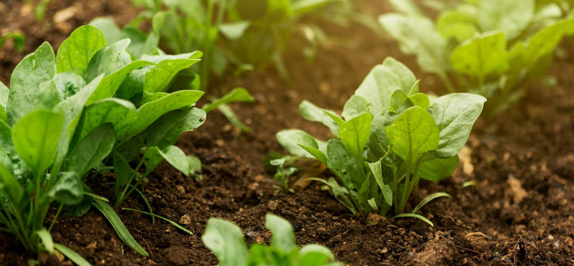
Thank You

